Slide 1
Shortest Path Algorithm
What is the Shortest Path Problem?
Is the shortest path problem well defined?
The Dijkstra's Algorithm for Shortest Path Problem.
Implementation Dijkstra's Algorithm

Slide 2
What is the shortest path problem?
In an edge-weighted graph, the weight of an edge measures the cost of traveling that edge.
For example, in a graph representing a network of airports, the weights could represent: distance, cost or time.
Such a graph could be used to answer any of the following:
  What is the fastest way to get from A to B?
  Which route from A to B is the least expensive?
  What is the shortest possible distance from A to B?
Each of these questions is an instance of the same problem:
The shortest path problem!

Slide 3
This Lecture
Single-source shortest paths in weighted graphs
  Shortest-Path Problems
  Properties of Shortest Paths, Relaxation
  Dijkstra’s Algorithm
  Bellman-Ford Algorithm

Slide 4

Shortest Path
Generalize distance to weighted setting
Digraph G = (V,E) with weight function W: E → R (assigning real values to edges)
Weight of path p = v₁ → v₂ → … → v_{k} is
Shortest path = a path of the minimum weight
Applications
  static/dynamic network routing
  robot motion planning
  map/route generation in traffic

Slide 5
Shortest-Path Problems
Shortest-Path problems
  Single-source . Find a shortest path from a given source (vertex s) to each of the vertices.
  Single-pair. Given two vertices, find a shortest path between them. Solution to single-source problem solves this problem efficiently, too.
  All-pairs. Find shortest-paths for every pair of vertices. Dynamic programming algorithm.

Slide 6
Negative Weights and Cycles?
Negative edges are OK, as long as there are no negative weight cycles (otherwise paths with arbitrary small “lengths” would be possible)
Shortest-paths can have no cycles (otherwise we could improve them by removing cycles)
  Any shortest-path in graph G can be no longer than n – 1 edges, where n is the number of vertices

Slide 7
Relaxation
For each vertex v in the graph, we maintain v.d(), the estimate of the shortest path from s, initialized to ∞ at the start
Relaxing an edge (u,v) means testing whether we can improve the shortest path to v found so far by going through u
u
v
u
v
2
2
Relax (u,v,G)
if v.d() > u.d()+G.w(u,v) then
v.setd(u.d()+G.w(u,v))
v.setparent(u)
5
9
5
6
Relax(u,v)
Relax(u,v)
5
7
5
6
2
2
u
v
u
v

Slide 8
Dijkstra's Algorithm
Non-negative edge weights
Greedy, similar to Prim's algorithm for MST
Like breadth-first search (if all weights = 1, one can simply use BFS)
Use Q, a priority queue ADT keyed by v.d() (BFS used FIFO queue, here we use a PQ, which is re-organized whenever some d decreases)
Basic idea
  maintain a set S of solved vertices
  at each step select "closest" vertex u, add it to S, and relax all edges from u

Slide 9
Dijkstra's algorithm - Pseudocode
Input: Graph G, start vertex s
dist[s] ←0 (distance to source vertex is zero)
for all v ∈ V–{s}
do dist[v] ←∞ (set all other distances to infinity)
π[v] ← NIL (set predecessor of all vertices except s as NIL)
π[s] ← NIL (set the predecessor of source vertex as NIL)
S←∅ (S, the set of visited vertices is initially empty)
Q←V (Q, the queue initially contains all vertices)
while Q ≠∅ (while the queue is not empty)
do u ← mindistance(Q,dist) (select the element of Q with the min. distance)
S←S∪{u} (add u to list of visited vertices)
for all v ∈ neighbors[u]
do if dist[v] > dist[u] + w(u, v) (if new shortest path found)
then d[v] ←d[u] + w(u, v) (set new value of shortest path)
π[v] ←u (set the predecessor of v as u)
return dist

Slide 10
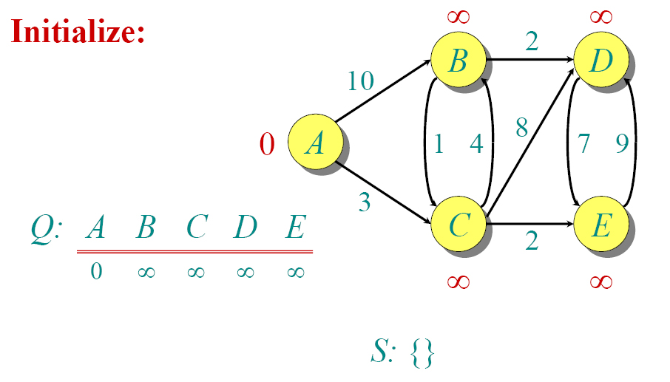
Dijkstra Animated Example

Slide 11

Dijkstra Animated Example

Slide 12

Dijkstra Animated Example

Slide 13

Dijkstra Animated Example

Slide 14

Dijkstra Animated Example

Slide 15

Dijkstra Animated Example

Slide 16

Dijkstra Animated Example

Slide 17

Dijkstra Animated Example

Slide 18

Dijkstra Animated Example

Slide 19

Dijkstra Animated Example

Slide 20
Dijkstra’s Pseudo Code
Input: Graph G, start vertex s
Dijkstra(G,s)
01 for each vertex u ∈ G.V()
02 u.setd(∞)
03 u.setparent(NIL)
04 s.setd(0)
05 S ← ∅ // Set S is used to explain the algorithm
06 Q.init(G.V()) // Q is a priority queue ADT
07 while not Q.isEmpty()
08 u ← Q.extractMin()
09 S ← S ∪ {u}
10 for each v ∈ u.adjacent() do
11 Relax(u, v, G)
12 Q.modifyKey(v)
relaxing edges

Slide 21
Dijkstra’s Example
u
v
1
Dijkstra(G,s)
01 for each vertex u ∈ G.V()
02 u.setd(∞)
03 u.setparent(NIL)
04 s.setd(0)
05 S ← ∅
06 Q.init(G.V())
07 while not Q.isEmpty()
08 u ← Q.extractMin()
09 S ← S ∪ {u}
10 for each v ∈ u.adjacent() do
11 Relax(u, v, G)
12 Q.modifyKey(v)
10
∞
∞
9
s
0
2
3
4
6
7
5
∞
∞
2
x
y
u
v
1
10
10
∞
9
s
0
2
3
4
6
7
5
5
∞
2
x
y

Slide 22
Dijkstra’s Example (2)
u
v
1
Dijkstra(G,s)
01 for each vertex u ∈ G.V()
02 u.setd(∞)
03 u.setparent(NIL)
04 s.setd(0)
05 S ← ∅
06 Q.init(G.V())
07 while not Q.isEmpty()
08 u ← Q.extractMin()
09 S ← S ∪ {u}
10 for each v ∈ u.adjacent() do
11 Relax(u, v, G)
12 Q.modifyKey(v)
10
8
14
9
s
0
2
3
4
6
7
5
5
7
2
x
y
u
v
1
10
8
13
9
s
0
2
3
4
6
7
5
5
7
2
x
y

Slide 23
Dijkstra’s Example (3)
u
v
1
Dijkstra(G,s)
01 for each vertex u ∈ G.V()
02 u.setd(∞)
03 u.setparent(NIL)
04 s.setd(0)
05 S ← ∅
06 Q.init(G.V())
07 while not Q.isEmpty()
08 u ← Q.extractMin()
09 S ← S ∪ {u}
10 for each v ∈ u.adjacent() do
11 Relax(u, v, G)
12 Q.modifyKey(v)
10
8
9
9
0
2
3
4
6
7
5
5
7
2
x
y
u
v
1
10
8
9
9
0
2
3
4
6
7
5
5
7
2
x
y

Slide 24
Dijkstra’s Running Time
Extract-Min executed |V| time
Decrease-Key executed |E| time
Time = |V| T_{Extract-Min} + |E| T_{Decrease-Key}
T depends on different Q implementations
Q | T(Extract-Min) | T(Decrease-Key) | Total
array | Ο(V) | Ο(1) | Ο(V ²)
binary heap | Ο(lg V) | Ο(lg V) | Ο(E lg V)
Fibonacci heap | Ο(lg V) | Ο(1) (amort.) | Ο(V lgV + E)

Slide 25
END

